Slide 1
EE 464 Term Project
The Isolated Ones
Selen Özge Özgür 2375566
Onat Şimşek 2375772
Onur Emirhan Con 2304384

Slide 2
Outline
Topology Selection
Magnetic Design
Simulation Results
Component Selection

Slide 3

Topology Selection
 | Efficiency | Output Ripple | Power Range | Complexity | Cost
Flyback Converter | Moderate efficiency | Higher output ripple | Low to medium power | Least Complex | Cheapest
Forward Converter | Better efficiency | Lowest output ripple | Medium to high power | Medium Complexity | Medium
Push-Pull Converter | Can also have good efficiency | Moderate output ripple | Medium power | Most Complex | Most Expensive

Slide 4
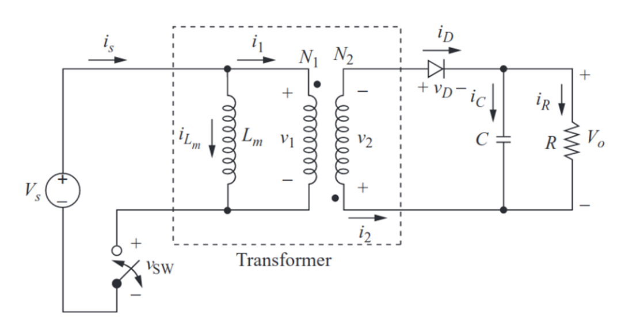
Topology Selection
Flyback Converter

Slide 5
Magnetic Design
Duty cycle range is determined
Turns ratio is determined to be 1:1, according to duty cycle
Lm is calculated according to specifications (Vin, Dmax, Bmax, etc.)
Core is determined after some research (ETD 39/20/13)
B66363G1000X187 with a gap of 1 mm
N87 type SIFERRIT material
Minimum number of turns required for the primary winding is determined
Exact number of turns is determined as 11
Lm is calculated again
B is calculated again to double check the design

Slide 6
Magnetic Design
Duty Cycle Range | Turns Ratio | Bmax | Calculated Lm | AL of the Core
0.24-0.39 | 1:1 | 0.2 T | 23.18 μH | 196 nH/T^2

Slide 7
Magnetic Design
Min # of Turns | # of Turns | Final Lm | Final Bmax | Switching Freq.
≈ 8 | ≈ 11 | 23.72 μH | 0.215 T | 80kHz

Slide 8
Magnetic Design
Skin Depth | Cable Type | # of Parallel Cables | Window Area of the Core | Fill Factor
0.265 mm | AWG 26 | 27 | 178 mm^2 | 0.46

Slide 9
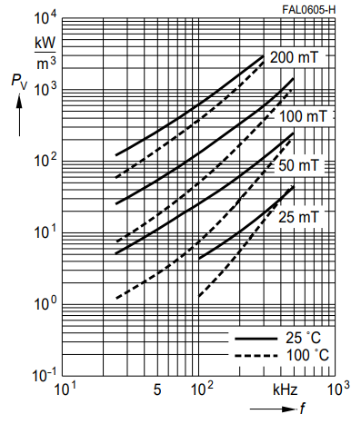
Magnetic Design
Copper Losses | Core Losses
0.67 W | 3.45 W

Slide 10
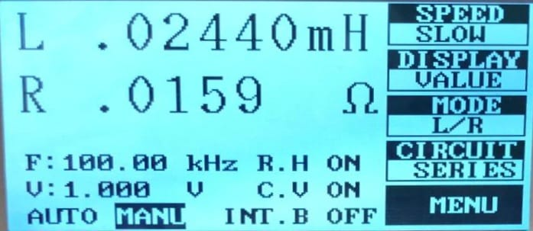
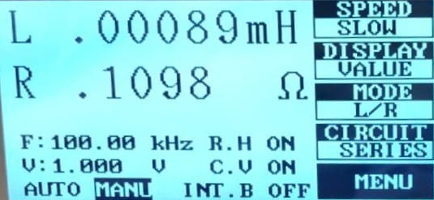
Magnetic Design Results
Primary Winding Inductance
Leakage Inductance

Slide 11
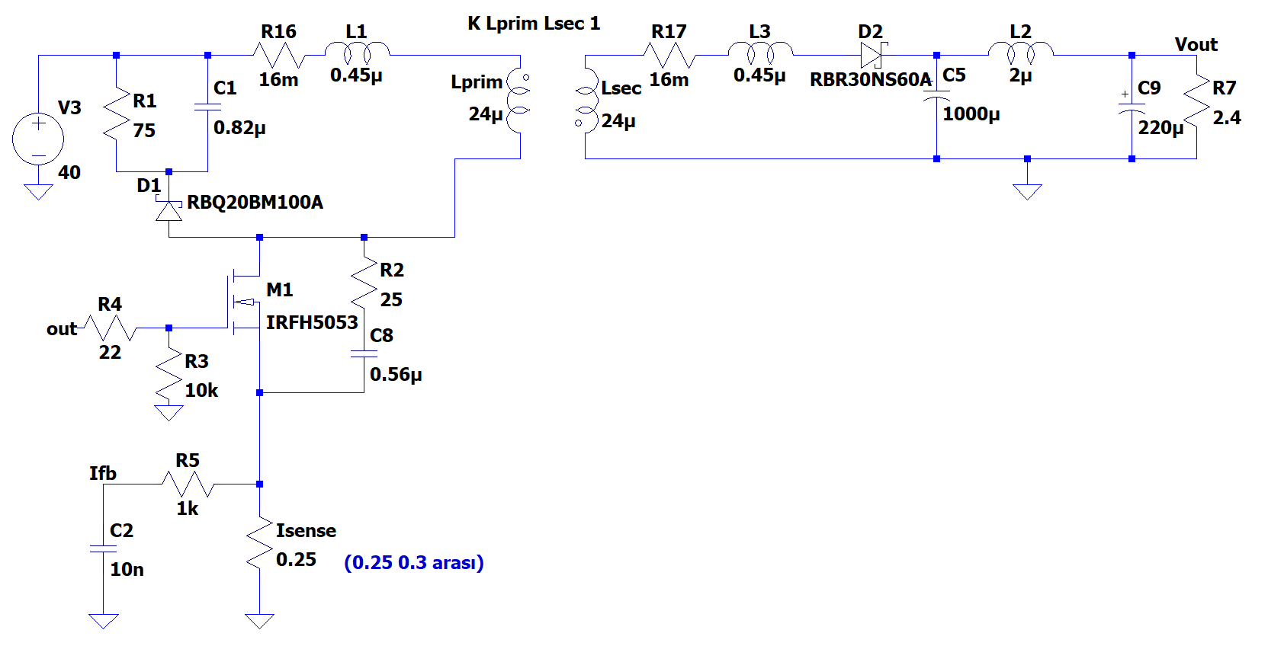
Simulation Results
Flyback Converter Design

Slide 12
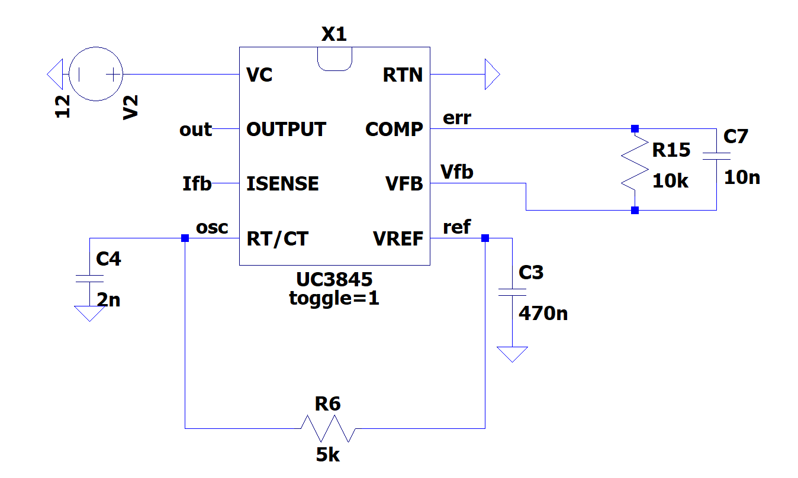
Simulation Results
Controller Design

Slide 13
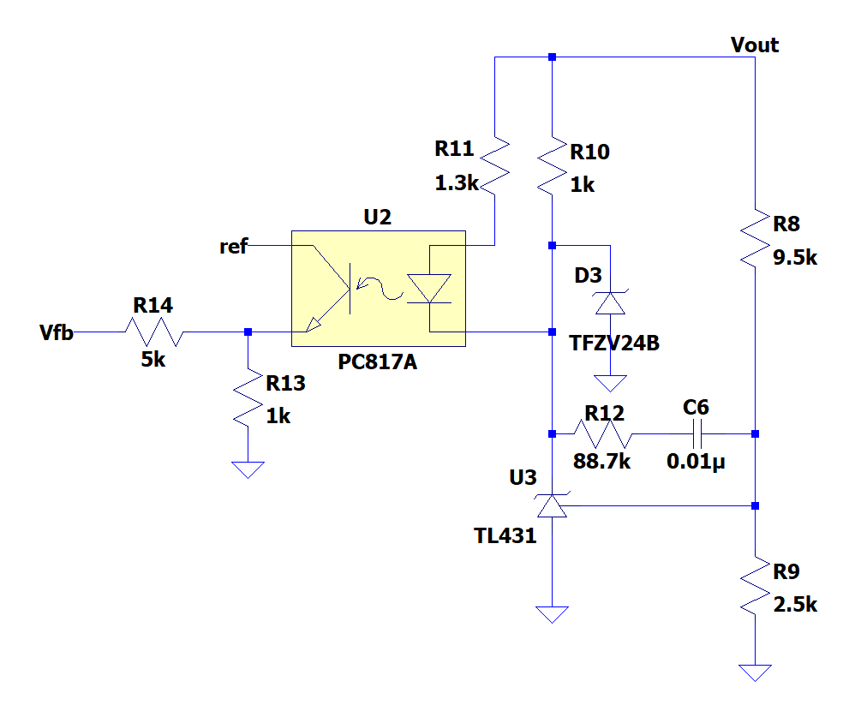
Simulation Results
Optocoupler Design

Slide 14
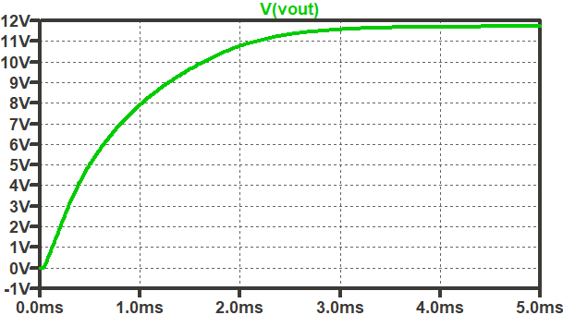
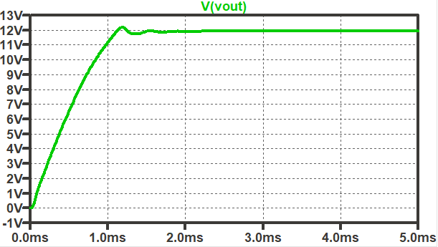
Simulation Results
Output Voltage Waveform for 20 V Input Voltage
(Steady state voltage : 11.7 V)
Output Voltage Waveform for 40 V Input Voltage
(Steady state voltage : 12 V)

Slide 15
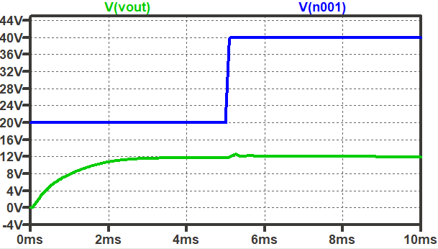
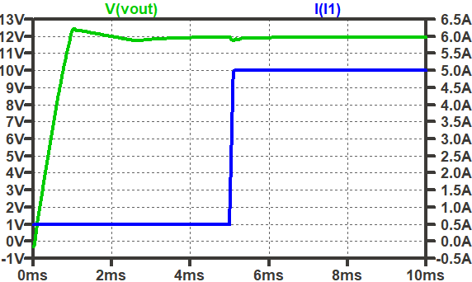
Simulation Results
Line Regulation: %5 (12.5V)
Load Regulation: %2 (11.76V)

Slide 16
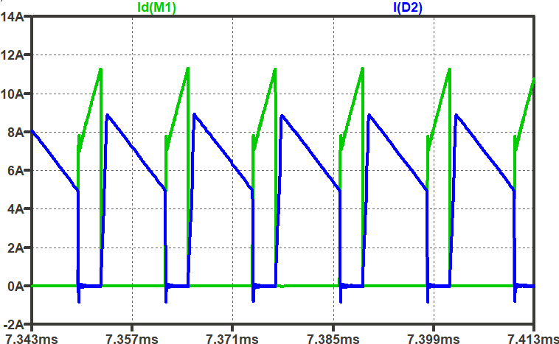
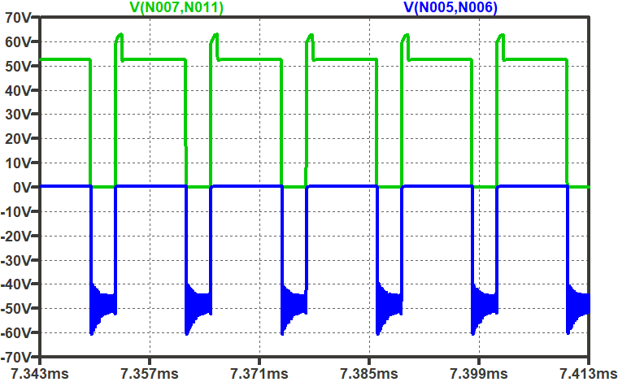
Simulation Results
MOSFET (Green) & Diode (Blue) Currents
MOSFET (Green) & Diode (Blue) Voltages

Slide 17
Component Selection
MOSFET Selection
Secondary Diode Selection
RCD Snubber Diode Selection
Rsense Selection

Slide 18
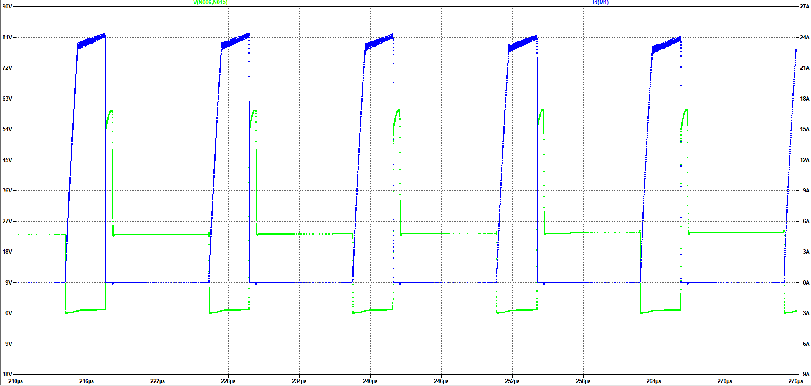
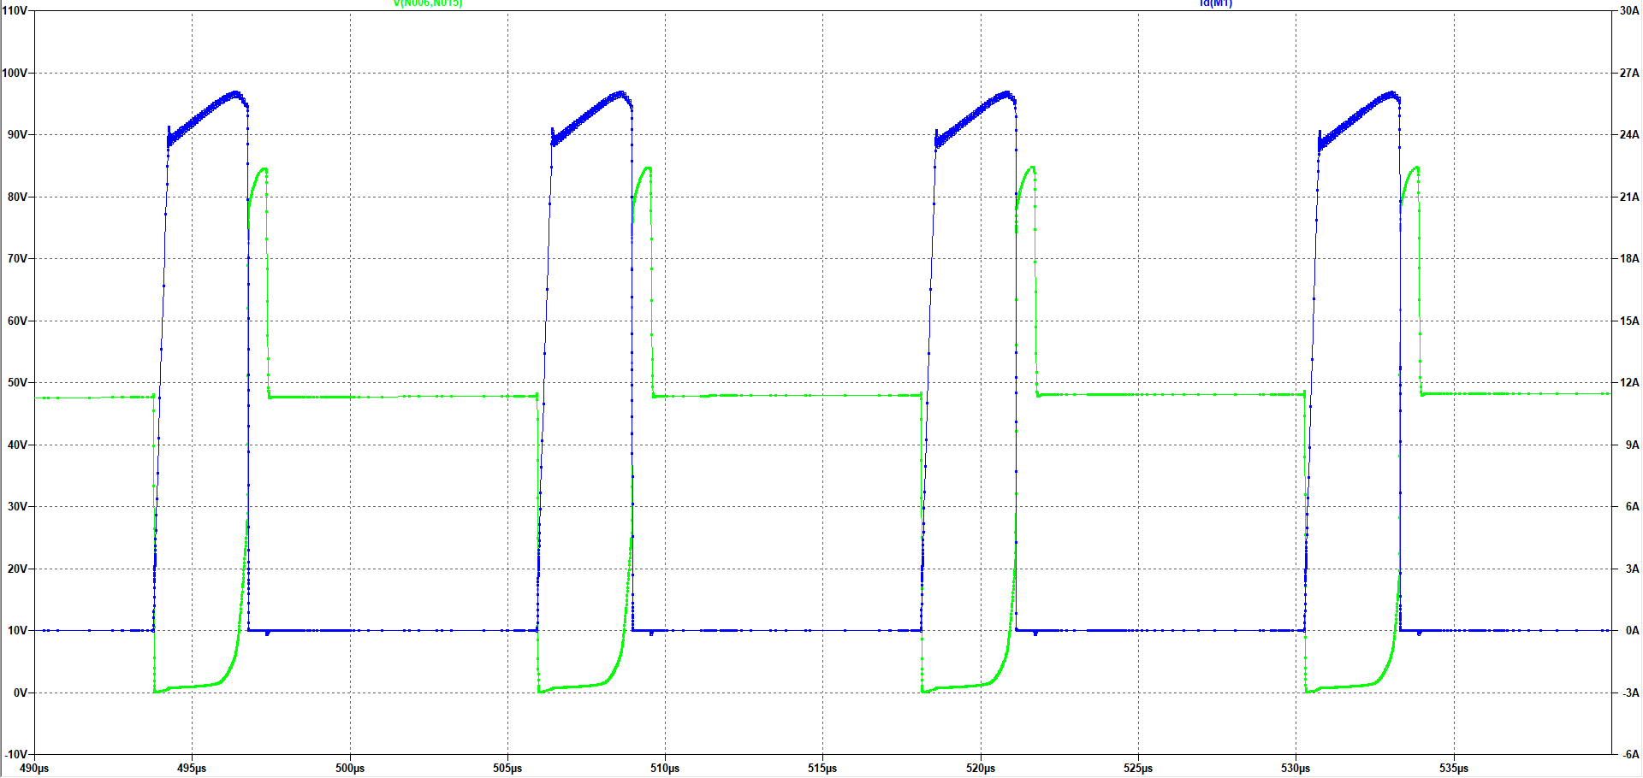
MOSFET
Voltage and Current Waveforms of the MOSFET for 20V Input Voltage
Voltage and Current Waveforms of the MOSFET for 40V Input Voltage
Max Voltage: 85V
Max Current: 25A
IRFZ540N (33A 100V)

Slide 19
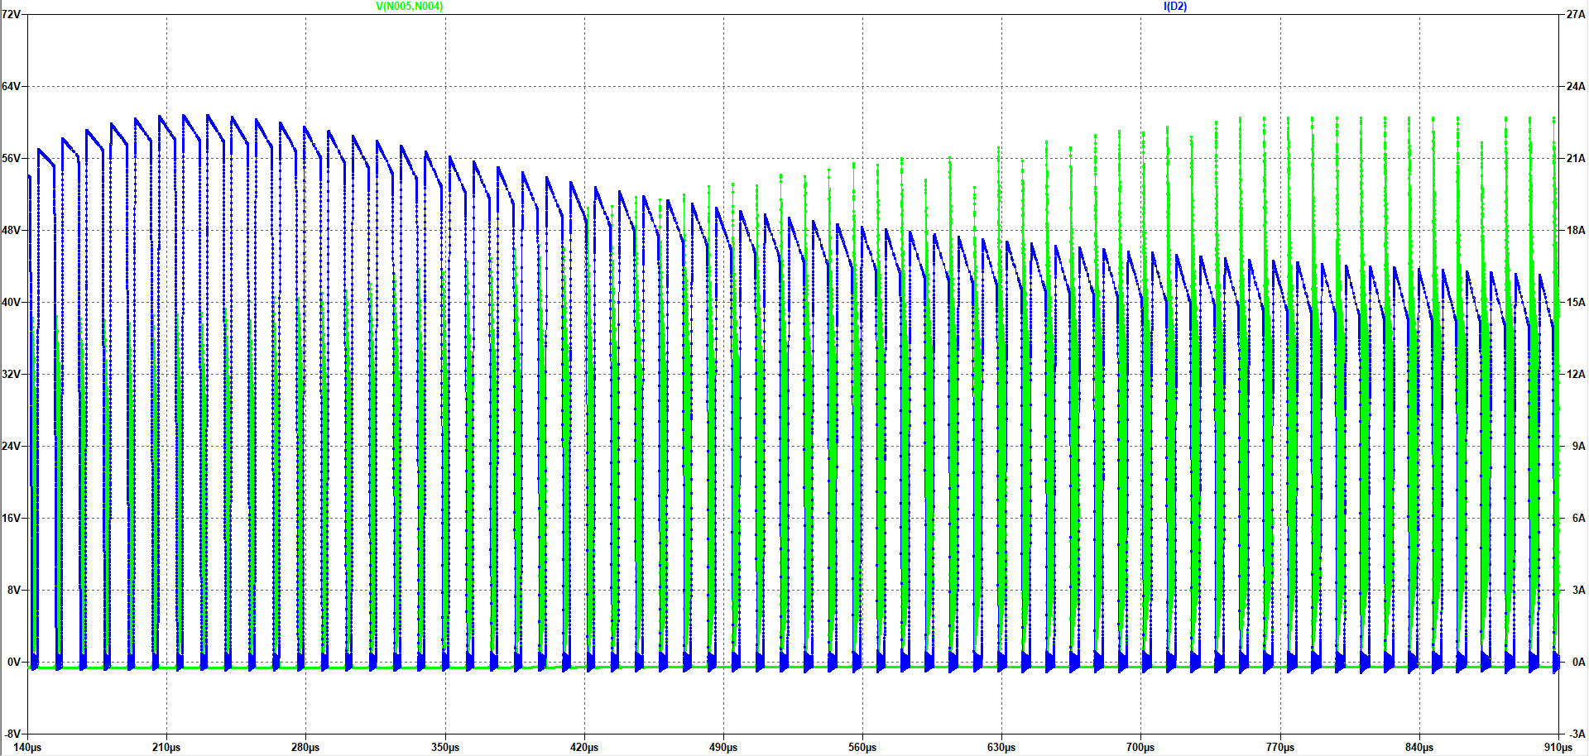
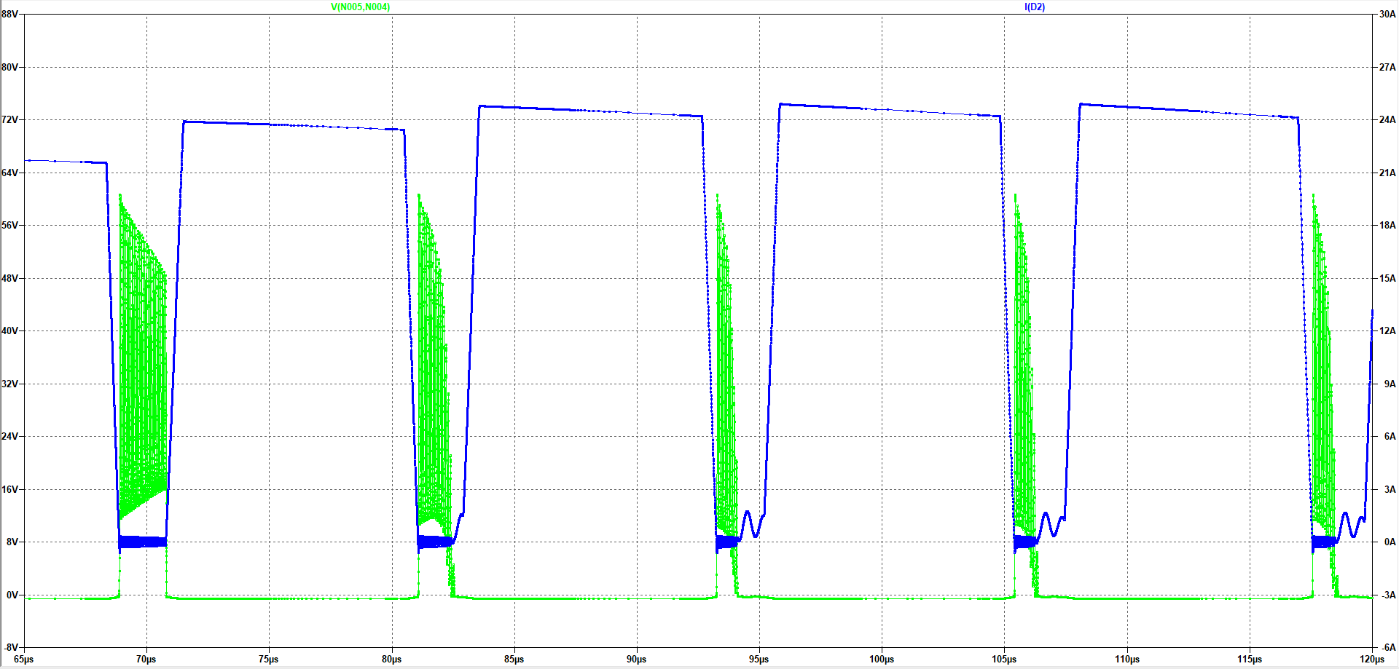
Secondary Diode
Voltage and Current Waveforms of the Secondary Diode for 20V Input Voltage
Voltage and Current Waveforms of the Secondary Diode for 40VInput Voltage
Max Voltage: 60V
Max Current: 25A
DSA30I100PA(30A 100V)

Slide 20
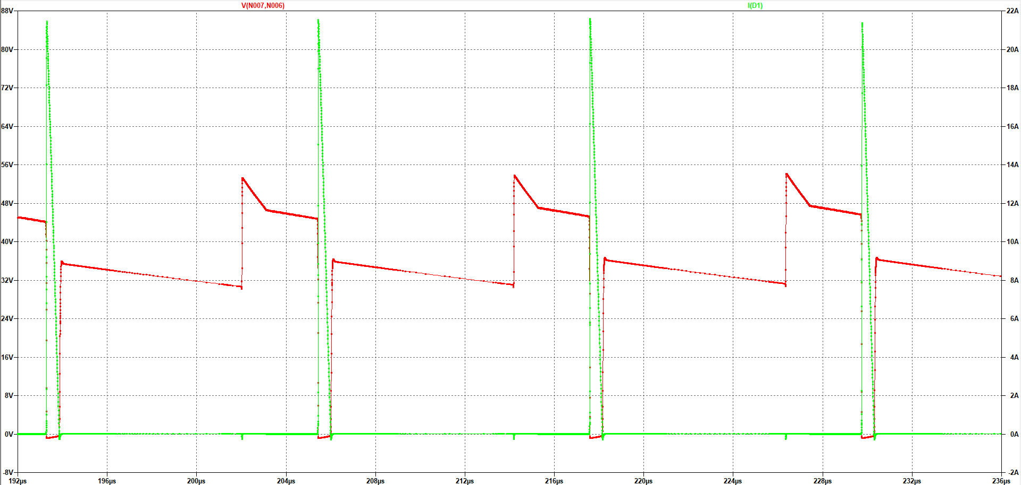
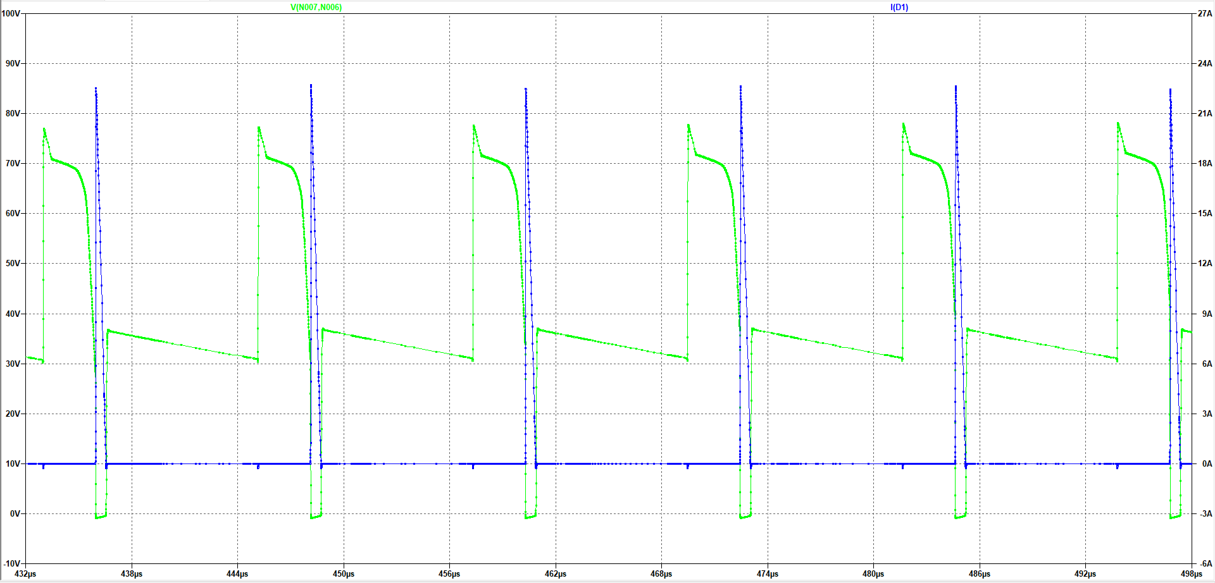
RCD Snubber Diode
Voltage and Current Waveforms of the RCD Diode for 20V Input Voltage
Voltage and Current Waveforms of the RCD Diode for 40V Input Voltage
Max Voltage: 78V
Max Current: 23A
DSA30I100PA(30A 100V)

Slide 21
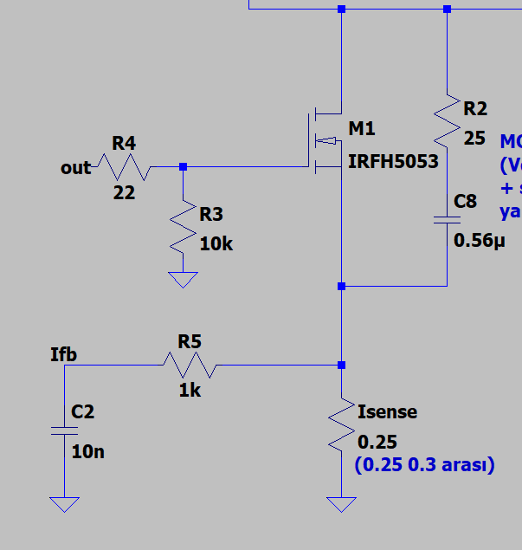
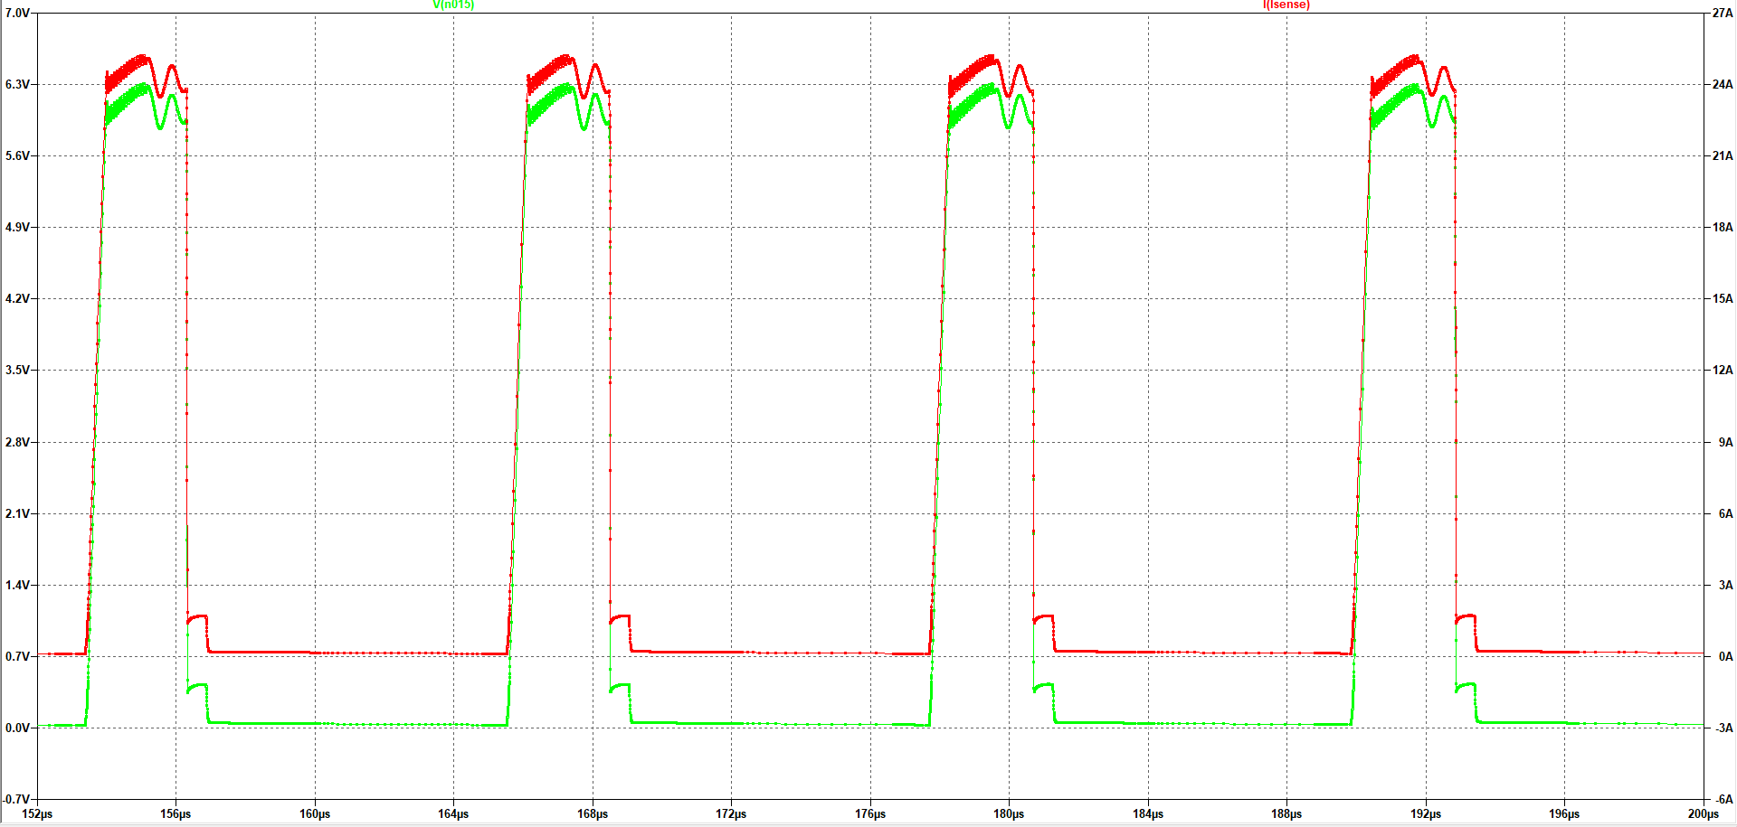
Rsense
Voltage and Current Waveforms of the RSense for 20V Input Voltage
ACS712 Current Sensor
+
Opamp Amplifier
Max Voltage: 6.3V
Max Current: 25.2A
R = 0.25 ohm

Slide 22
Thank You for Your Listening

